Slide 1

Impact of Financial Crisis on Mental Health : Greece
Stelios Stylianidis,
Prof. of Social Psychiatry, Panteion Univ. Athens
Sc. Director of EPAPSY

Slide 2
Diagram of the Presentation
Framework of the Greek Crisis
Impact on Public Health and Social Welfare
Impact on Mental Health
Impact on Human Rights and Treatment
Cost-effective actions to tackle the impact
  Mobile mental health unit of Cyclades: Serving mental health in remote areas
  Empowerment of Families and Users in mental health
  Self-help groups for depression in urban and rural settings
  Promoting mental health through key agents: Church and mental health
  QualityRights Project
Concluding Remarks

Slide 3
Framework of the Greek Crisis

Slide 4
Social Insecurity, Individuality and Precariousness
R. Castel
Society is transforming to an “individualized society”. Insecurity increases dramatically since collective regulations cannot satisfy the individual. Social Insecurity is closely connected with not having solid support systems which can allow someone to feel “in control” of his own future.
The individuals have to live “day by day”.
The phenomenon is more than exclusion; It is a collective loss of essential attributes that characterize large parts of social classes.
Risk is everywhere and drives modern society to a “society of risk”. Risk is tied with “social uncertainty”. Individuals who belong to socially vulnerable groups (unemployed, homeless, people receiving social benefits) are not seen as “100% individuals”. They lack the options to lead their own lives frequently depending on the needs and “benevolence” of the others or from social benefits which makes them feel as “strangers (pariahs) to society”.
Z. Baumann
Transition from solid modernity to a more liquid form of social life.
In liquid modernity, constructing a durable identity that coheres over time and space becomes increasingly impossible, according to Bauman. We have moved from a period where we understood ourselves as “pilgrims” in search of deeper meaning to one where we act as “tourists” in search of multiple but fleeting social experiences.

Slide 5
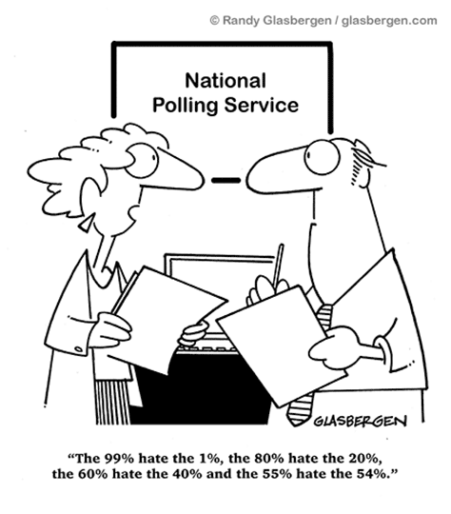

Slide 6
Impact on Public Health and Social Welfare

Slide 7
Recent Data I (National School of Public Health, 2013)
20% of the total health budget is spent for medicine
1 out of 3 Greek patients is forced to differentiate his therapy, taking less and less dosage of medicine to make it last longer due to financial strain
60% of the chronic patients face restricted access to health services or long waiting list
The chronic patients have reduced by 30% their visits to PHC Services for 2011 – 2013
The chronic patients have reduced by 50% their expenses for Primary Health care for 2011 - 2013
50% increased hospitalization due to major depression due to financial crisis
In a decade it is expected that life expectancy will be reduced by 3 years as a result of the worsening quality of life.
Sine 2008 infant mortality rate has risen from 3.31 to 4.28 in 2009, 4.36 in 2010 and 4.01 in 2011.

Slide 8
Recent Data II: Pharmaceutical Expense and Chronic Diseases
According to Troika commands, the public pharmaceutical budget for 2013 should be about 2.35 billion euro in 2014 while the final goal is 1% of the GDP of the country, meaning 1.7 – 1.8 billion euro.
The public pharmaceutical expense per capita for a year will then be about 170 euro, which is the lowest of OECD countries.
The reduction in price and percentage of benefit have contributed in reducing public pharmaceutical expense.
8 out of 10 Greeks are forced to cut down on essential needs in order to keep up with the medication.
4 out of 10 Greeks reduce the quantity of food to save for medicine
8 out of 10 patients reduce their expenses for housing, transportation and communication in order to save for their medical treatment, while 4 out of 10 cut down on the nutrition
The arbitrary modification of therapy in several chronic, temporary or other diseases increases rapidly the possibility of relapse and premature mortality.
Every household has lost about 530 ₠ on average. Maximum loss is 1.115 ₠ per month.
Dementia
  As the patient’s condition worsens and transitions from the mild stage to more severe, the cost and loss of productivity also rise.
  The monthly cost for a patient in the autonomous stage is 341 €, at the stage of dependence from the carer the cost rises to 957 € and in the end at the final stage of disability and dependence (which could mean his longterm stay in an institution) rises to 1267 € (Kyriopoulos, 2010).
  ¾ of care in Greece is provided by the family members at home (increased family burden, increased prevalence of depression among carers)

Slide 9
National School of Public Health, 2013
In the Urban Centres, chronic diseases such as hypertension, diabetes, chronic respiratory failure and dementia are responsible for 70% of the demand for health services and absorb 50& of the national healthcare budget.
European Commision: Greece shows the largest reduction on health expenses per capita (2010: -12%, 2011: -14%). In 2011 the cost per capita for health was 1.179 e and it has been reduced by 26% for 2010-2011.
2007 – 2011: 50% increase in unmet health needs
Uninsured citizens are 3.000.000 (27.7% of the general population)
“A bubble was created in Health and obviously there was margin for the reduction of cost. Nevertheless, the reduction should take place in an organized and rational way. Unfortunately, this did not happen. The reductions were horizontal without focusing on the real data and the current needs.” (Syrigos, Prof. of Med. School, Director of Oncology in Soteria GH, 2013)

Slide 10
Structural Problems in the National Healthcare System (ESY)
Irrational distribution of services
Large number of Insurance Funds with different regulations for provisions and different rates of contribution
Infiltration of the Private sector in public health
Lack of essential control of the financial data of the system which were unrelated with the produced services.
The politics of budget cuts proved inefficient. The regulations which were changed showed only temporary results with no positive contribution to the restructuring of health sector.
The compression of budget for pharmaceutical products has been reduced by 50% while for technological and healthcare products more than 60%. Major issues of efficacy have been arisen.
The European Public Expense per capita (2013) is +50% of the Greek.

Slide 11
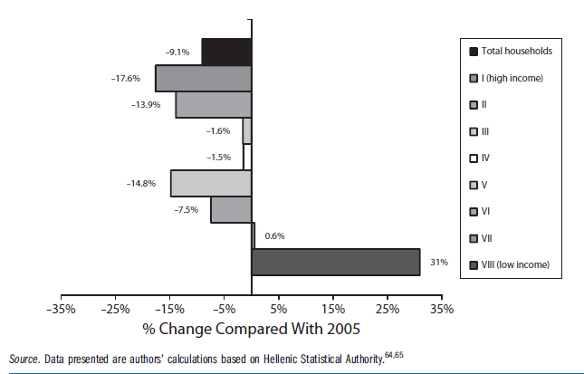
Households’ health expenditures (calculated as percentage of households’ total expenditure) by households’ income class: Greece, 2009.
(Kondilis et al., 2013)
Low-income households during the crisis spent an even larger share of their reduced
income to access health services such as pharmaceuticals and hospital services.

Slide 12
Poverty and Unemployment
Unemployment rate rose from 24.8% (2012) to 27% (2013)
36.4% of the Greek population lives at risk of poverty and social exclusion
People at risk of poverty or social exclusion
Poor social and economic circumstances affect health throughout life. People further down the social ladder usually run at least twice the risk of serious illness and premature death as those near the top. Nor are the effects confined to the poor: the social gradient in health runs right across society, so that even among middle-class office workers, lower ranking staff suffer much more disease and earlier death than higher ranking staff. (WHO, The Solid Facts, 2003)

Slide 13
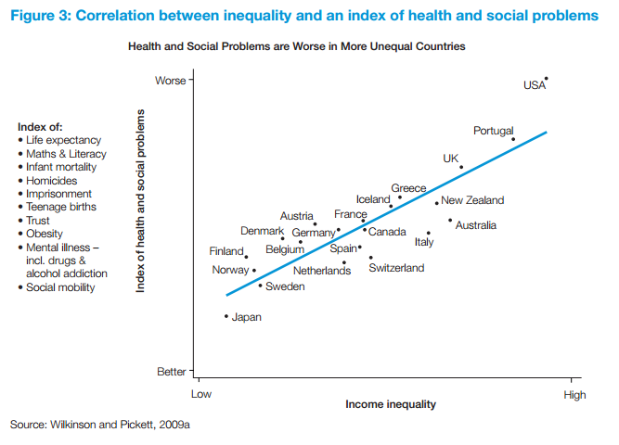

Slide 14
Impact on Mental Health

Slide 15
Grief or Depression?
Risk factors such as humiliation, defeat or the lack of any prospects that things will get improved in the future can transform a grieving process to depression. (Brown et al., 1995; Farmer and McGufﬁn, 2003; Kendler et al., 2003).
Increased prevalence of major depression 8.2 % in 2011 compared to 3.3% in 2008 (Economou et al., 2013)
People who experience high financial strain manifest a higher number of depressive symptoms in comparison to people with low financial strain.
Depression was found to be inversely associated with cognitive social capital for people in low economic hardship, this did not hold true for generalized anxiety disorder. (Economou et al., 2014)
Children and Adolescents Mental Health (Anagnostopoulos and Soumaki, 2013)
  Cases of psycho-social problems have risen by 40 %, cases of behavior disorders have risen by 28 %, cases of suicide attempts have risen by 20 %, cases of school drop-out have risen by 25 %, cases of bullying have risen by 22 %, cases of the use of illegal addictive substances have risen by 19 %, and cases of family discord have risen by 51 % (due to parental unemployment, serious financial problems, and exorbitant debts).
  Data from adolescent inpatient units showed an admission increase of up to 84%, with diagnoses on admission of borderline conditions, severe behavioural disorders, acute psychotic crises, self-harm behaviours, and other similar conditions constituting 78 % of the total cases in 2011, compared to only 48 % in 2007.

Slide 16
Suicide rates and profile
Year | Men | Women | Total | per 100.000
2007 | 268 | 60 | 328 | 3.0
2008 | 268 | 65 | 333 | 3.1
2009 | 333 | 58 | 391 | 3.6
2010 | 336 | 41 | 377 | 3.5
2011 | 393 | 84 | 477 | 4.4
Work status
20.9% unemployed | 7.1% Public Workers | 5.6% Private Workers | 6.5% Freelance | 5.5% Undergraduate students | 4.5% Students | 39.2% Unidentified
Recent research (Giotakos, Karabelas, Kafkas 2011; Stuckler et al., 2009) associates unemployment and increase in homicides and suicidal behaviour.
Every 1% increase in unemployment is associated with a 0,79% rise in suicides at ages younger than 65 years and every +3% increase in unemployment is associated with a 4,45% rise in suicides. (Stuckler, 2009)

Slide 17
Epidemiological Research for mental disorders, Greece, 2010
Socio-economic inequity and mental health
Work
Status

Slide 18
Crisis and Mental Health in Greece
75% of the population with at least one common mental disorder does not receive any treatment at all for its condition. (Mavreas, 2011)
Psychotropic Drugs
  18,59% increase in the use of antipsychotics (2006-2011)
  34,80% increase in the use of antidepressants (2006-2011)
(Kyriopoulos, 2011)
The significant predictors of a recent suicide attempt in 2011 were the presence of major depression during the previous month, financial hardship, a previous history of suicide attempt, being male, and being married. (Economou et al., 2013)
Hotlines of Psychological Support have noted an increased number during 2010, of calls for psychological problems due to the financial crisis (27%) (EPIPSI, 2010).
Suicidal ideation was also increased between 2009 and 2011 among respondents who used psychotropic medications (22.7% vs. 4.5%) and those who had sought help from a mental health professional (17.3% vs. 8.3%).
36% increase of the self-reported suicide attempts from 2007 to 2011 (Economou et al., 2011)

Slide 19
Impact on Human Rights and Treatment

Slide 20
Research programme for investigating the high rates of involuntary hospitalizations
A research programme for investigating the high rates of involuntary hospitalizations in Athens area was initiated. The research programme entails a number of research projects with different research aims and methodologies. Some of these projects are mentioned below:
A cross-sectional study exploring the rates of compulsory admissions at the Psychiatric Hospital of Attica “Dafni” as well as the socio-demographic and clinical variables that predict involuntary hospitalization (a similar study was also conducted at Sismanogleio Hospital)
A cohort study exploring the 2-year outcome of an index hospitalization (involuntary vs. voluntary). Outcome is assessed in terms of symptomatology, functioning and rehospitalization (sub-analyses address particular clinical sub-groups: first episode psychosis, revolving door patients, etc.)
A cross-sectional survey investigating the degree to which the pertinent legislation is implemented
Qualitative interviews with family members of patient who have been involuntarily hospitalized
Qualitative interviews with involuntarily hospitalized patients about their experience of coercion
Qualitative interviews with voluntarily hospitalized patients about their hospital stay
A focus group with mental health professionals on the problems faced by the staff at the Psychiatric Hospital of Attica
A cross-sectional survey on mental health professionals who work at the Psychiatric Hospital of Attica as well as in community mental health services on their attitudes to severe mental illness and compulsory admissions

Slide 21
Main Findings
Very high rates of compulsory admissions in Athens (around 60% in Dafni, 50% in Sismanogleio).
Discontinuity of care among mental health services is the main- but not the only-explanation for this high rate.
The implementation of the pertinent legislation the Psychiatric Hospital of Attica is better than it used to be , but it is not optimum yet.
Patients display substantial reduction in symptom severity and better functioning upon discharge from Dafni; however, these benefits are not sustained in the long-run
Even mental health professionals in community residents hold stigmatizing attitudes towards severe mental illness and opt for compulsory admission.
Patients report ambivalent feelings towards their involuntary hospitalization, while their relatives often consider it as the only route for helping them.

Slide 22
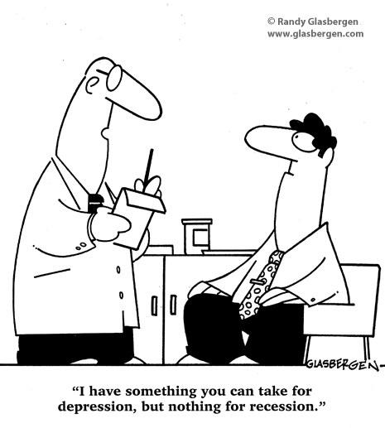

Slide 23
Cost-effective actions to tackle the impact
  Mobile mental health unit of Cyclades: Serving mental health in remote areas

Slide 24
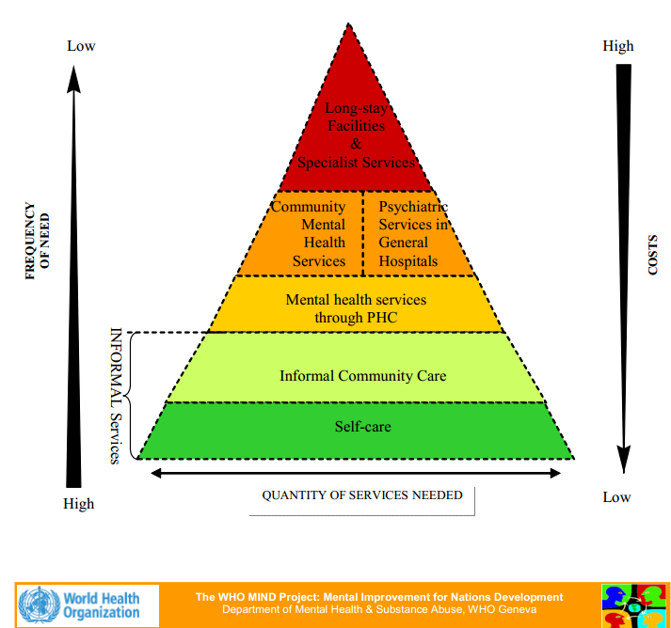

Slide 25
EPAPSY
The Association for Regional Development and Mental Health - EPAPSY is a nongovernmental, non-profit organization, which operates in the field of psychosocial rehabilitation and mental health promotion. It was founded by the Prof. of Social Psychiatry S. Stylianidis in 1988. EPAPSY was founded with the joint purpose of a) promoting mental health in regional Greece and urban city centres, b) advancing scientific knowledge through research and training, c) implementing and disseminating innovative interventions according to evidence-based practices in the fields of social psychiatry and psychosocial rehabilitation and d) promoting human rights of people with mental disabilities.
EPAPSY currently serves approximately 2.272 mental health users and family members. It employs 206 mental health professionals, psychologists, psychiatrists, social workers, carers, administrative staff, and clinical supervisors. All employees receive frequent in-house training to continuously improve the quality of rendered services.

Slide 26
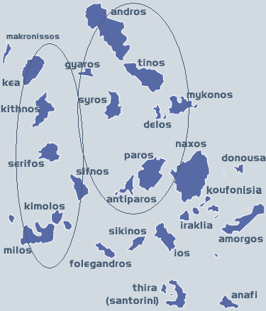
Mental Health Mobile Units of Northeastern and Western Cyclades Islands

Slide 27
Function
10 years of service (since 2003)
Financed by the Ministry of Health (first year 75% EU and 25% Ministry of Health)
Multidisciplinary teams of psychologists, psychiatrists, child-psychiatrists and working part-time (two-three days every two weeks) in the eleven islands: 12 psychologists, 5 psychiatrists, 6 child psychiatrists, 2 secretaries
Administration offices in Paros: full-time secretaries working 5 days a week
Services by mental health professionals of the mobile units are provided mainly in Health Centers
Every multidisciplinary team is coordinated by the scientific advisor
Supervision takes place by Prof. Stylianidis (management issues for the scientific advisors, clinical supervision)
Twice a month clinical supervision (psychoanalytically directed) takes place (adults and children)
Training seminars for the multidisciplinary team take place almost once a month

Slide 30
SERVICES PROVIDED/INTERVENTION IN THE COMMUNITY
Diagnosis, Psychotherapy, Drug treatment, Family counseling, evaluation and treatment of developmental disorders, evaluation and intervention in learning difficulties, provision of medical reports.
Organizing the efforts for creation of retirement homes and other focused units for the “vulnerable “ populations
Working-out and application of psychosocial rehabilitation and mental health services implementation projects.
Educational seminars, related to depression, social stigma, learning difficulties, behavioral problems, to Health professionals, Teachers and lay people.
Mental health and social service professional training.
Implementation of services and units for the rehabilitation of chronic psychiatric patients and persons with special psychosocial needs.
Counseling services and research upon issues concerning psychosocial needs, health/mental and social policy.

Slide 31
Cost-effective actions to tackle the impact
  Empowerment of Families and Users in mental health

Slide 32
Determinants of mental health: risk factors
Family
Poverty, poor education, deprivation, high debt
Poor prenatal nutrition, abuse, harsh upbringing, poor relationship to parents, intergenerational transmission of mental health problems
Unemployment, job insecurity, job stress
Alcohol and/or drug use

Slide 33
Determinants of mental health: protective factors
Family
Social capital and welfare protection
Healthy prenatal and childhood environment
Healthy workplace and living
Health lifestyles

Slide 34
Association for Families and Users in mental health: Actions taken at multiple levels
Local Level
Promotes the organization of families in Associations creating meeting points for self help and solidarity.
National Level
Influence decision making processes for the participation of family and user representatives.
International Level
Regular member of the National Federation of Persons with Disabilities (ESAEA)
Act as political pressure for local municipalities and institutions.
Establish centers for occupation and support while employing actions for the reduction of stigma in mental illness.
Promotes issues concerning persons suffering from a mental illness and their families.
Submits suggestions for law regulations.
Organizes, co-ordinates meetings and training activites for all the members in Greece.
Participates actively in congresses, and other events for mental health throughout Greece.
Participates in the special Committee for the Protection of Human Rights of persons suffering from a mental ilness
Board Member of the Greek Branch of the World Association for Psychosocial Rehabilitation (WAPR)
Tries to benefit and exchange knowlegde with other organizations at an international level; specifically by participating in EUFAMI and GAMIAN activities
2500 families participate in the Associations in Greece
500 users participate in associations for families and users or in self-representation associations

Slide 35
Cost-effective actions to tackle the impact
  Self-help groups for depression in urban and rural settings

Slide 36
Mutual Help Groups for Mental Health Problems:
A Review of Effectiveness Studies (Pistrang et al., 2008)
positive changes in mental health for group members
mutual help groups have equivalent outcome to those of established, more costly, professionally-provided psychological interventions (Bright et al., 1999; Marmar et al., 1988)
no differences in mental health outcomes between mutual help group members and non-members;
no studies showed any evidence of negative effects for self help groups

Slide 37
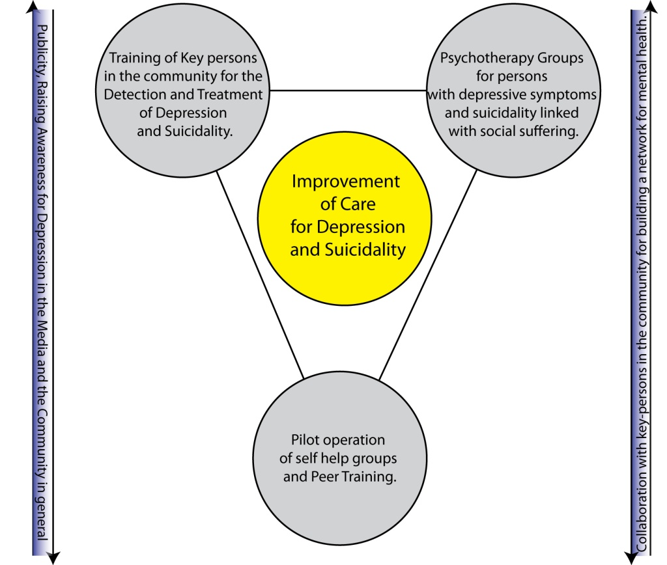
Axis 1: Training of Key persons in the community for the Detection and Treatment of Depression and Suicidality.
Axis 2: Psychotherapy Groups for people with depressive symptoms and suicidality linked with social suffering.
Axis 3: Pilot operation of self help groups and Peer Training.
Target Areas: 4 urban areas of Athens and 4 remote islands of Cyclades

Slide 38
Cost-effective actions to tackle the impact
  Promoting mental health through key agents: Church and mental health

Slide 39
Social Structures for Immediate Tackling of Poverty
Centre of Mediation
Social Convenience Store
Social Structure for Food
Social Pharmacy
Target population: Uninsured or Unemployed Individuals living in Halandri Area can receive medicine, essential products from the Store, food and psychosocial support services (interconnection with health services and welfare, mediation for solving social issues, individual and group consultation etc.).
The above collaboration co-funded by the ESF, is realized by Poreia NGO, the General Charity Foundation of the Holy Archdiocese of Athens and EPAPSY who work with the Municipality of Halandri and the Kourtesi Foundation in order to organize and deliver services against poverty.
More than 160 demands have been met delivering psychosocial support to 250 citizens.
EPAPSY and Archdiocese of Athens will sign a protocol of collaboration in order to support increasing number of demands from the community for delivery of services in prevention, mental health promotion, psychosocial support and strengthening of social capital.
Local networks with the collaboration of Local Parishes are gradually built with the goal of delivering psychosocial services as close to the population as possible either supporting the priests (indirect) or providing psychosocial services at a specified place in the parish (direct support).

Slide 40
Cost-effective actions to tackle the impact
  QualityRights Project

Slide 41

Act, Unite and Empower for Better Mental Health
Objectives of the QR project
Improve the quality of services and human rights conditions in inpatient and outpatient mental health facilities
Build capacity among service users, families and health workers to understand and promote human rights and recovery
Develop a strong civil society movement of people with psychosocial disabilities to provide mutual support, conduct advocacy and lobby for reform
Reform national policies and legislation in line with best practice and international human rights standards
Notes:
41

Slide 42
Act, Unite and Empower for Better Mental Health
Key dimensions of the QR project
Uses the UN Convention on the Rights of Persons with Disabilities as a framework
On the ground (facility-level) improvements as well as at policy level
Inpatient, outpatient and community services are all addressed
Use of participatory and inclusive approach
Building of an international network of people with psychosocial disabilities, families and health professionals to work as consultants in other countries
Notes:
42

Slide 43
Act, Unite and Empower for Better Mental Health
WHO QualityRights in countries
QR countries to date: Spain, Portugal, Panama Palestine and Somalia.
QR in Greece
  Nov 2011 workshop to train on quality and human rights, how to conduct an assessment and use the WHO QualityRights Toolkit
  Workshop attended by high level representatives from government (MOH, Ombudsman for social protection, health and social solidarity, members of associations of Users and Families etc.)
  A Management team has been established to be oversee the assessment
  Assessments of facilities will be underway in the next months.
Future QR countries: Chile, Brazil, India

Slide 44
Conclusive remarks

Slide 45
Future Challenges for the Public Mental Health System in Greece (Stylianidis, 2012)
Public expenditures are dramatically reduced affecting mental health services and the social and health services as well.
The continuous regression of deinstitutionalization and the process of psychiatric reform will cause more violations of human rights of people suffering from mental health problems and will also increase all risk factors (chronic stress, poverty, inequality and poor access to promotion, prevention and treatment interventions).
Resource Allocation from MH Hospitals to Community Care
Funding and Financing of services which are being continually evaluated for their resutls.
Institutional and Active involvement of users and families in the planning, realization and evaluation of services.
Hope-Based System VS Fear-Based System

Slide 46
Philosophy, Democracy and Austerity
Human rights are most clearly represented by the basic rights legally institutionalized within constitutional democracies, since such basic rights are the only rights that fully realize both the legal and the moral sides of the concept of human rights.
Beyond this level, human rights remain only a weak force in international law and still await institutionalization within the framework of a cosmopolitan order that is only now beginning to take shape. (J. Habermas)
The austerity policy and measures lead to the increase of “populism” and fascism trends in society while threatening to kill democracy.
  “Morire di austerita”, Lorenzo Bini Smaghi, ESF, 2013
    Birth rate
    2008-09: 118.000
    2012: < 100.000 (15% reduction)

Slide 47
As Ron Coleman (2012) systematically points out power is not given but taken. In his own words: we have to take the right for recovery by ourselves, we must learn to own our experience, our recovery, this is not the professionals’ recovery, their role is to assist our recovery. For too long we told people what to do and not ask for what they want to do, we should not ask what do you feel, we should be asking what do you want, what you need. We should stop see recovery as a word, recovery should be an action. If we make recovery an action, then we can see people stop committing suicide, we can see them fighting for empowerment.

Slide 48


Slide 49
Thank you very much for your attention!
Contact Details
Stelios Stylianidis, Prof. of Soc. Psychiatry, Panteion Un.
epapsy@otenet.gr
(0030) 210 61 41 350
EPAPSY
www.epapsy.gr

